Slide 1
How does the web work?
A website is simply a collection of web pages of codes – codes that describes the layout, format and content on a page.
The web server is a internet-connected computer that receives the request for a web page sent by your browser.
The browser connects your computer to the server through an IP address. The IP address is obtained by translating the domain name. (Don’t worry, this part is all done automatically by your browser so you don’t have to look up the IP addresses yourself.)
In other words, in order to display your website on the Internet, you will need:
1-A website
2-A domain name
3-A server

Slide 2
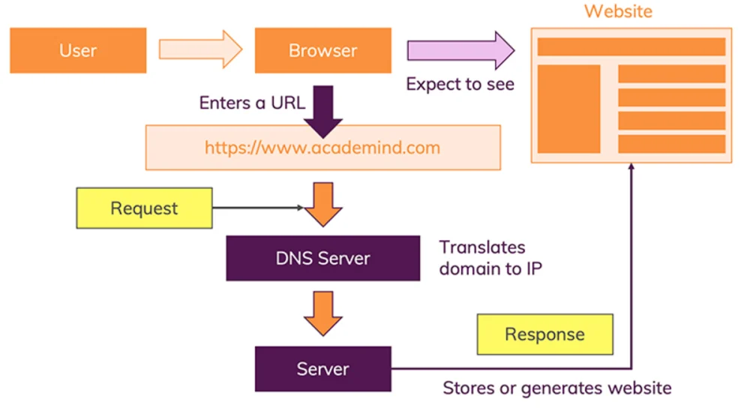
How does the web work?

Slide 3
What do you need to be a web developer?
In doing so, it’s important to note there are two categories of web developer jobs: front-end development and back-end development and now fullstack developer :
FRONT END WEB DEVELOPMENT SKILLS
-HTML
-CSS
-JavaScript
BACK END WEB-DEVELOPMENT SKILLS
JavaScript / NodeJS
Ruby / Ruby on Rails
JAVA,
PHP
API

Slide 4
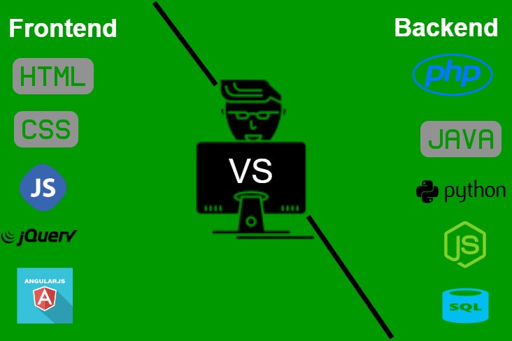
What do you need to be a web developer?
Below this image illustrate the details between Back end and front end technologies ,

